Slide 1
Port Lincoln Council (FY 2020-2021)
View in Power BI
Last data refresh:
9/14/2021 4:05:25 AM UTC
Downloaded at:
10/1/2021 6:44:39 AM UTC

Slide 2
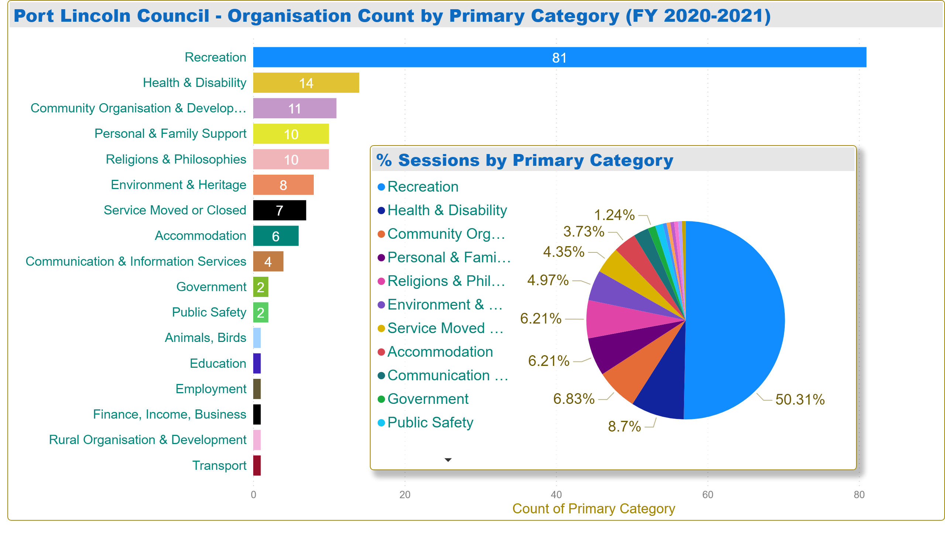
Sessions by Primary Category
Notes:
Port Lincoln Council - Organisation Count by Primary Category (FY 2020-2021)
No alt text provided.
% Sessions by Primary Category
No alt text provided.

Slide 3
Sessions by Organisation
Notes:
% Sessions by Organisation
No alt text provided.
Port Lincoln Council - Sessions by Organisation (FY 2020-2021)
No alt text provided.

Slide 4
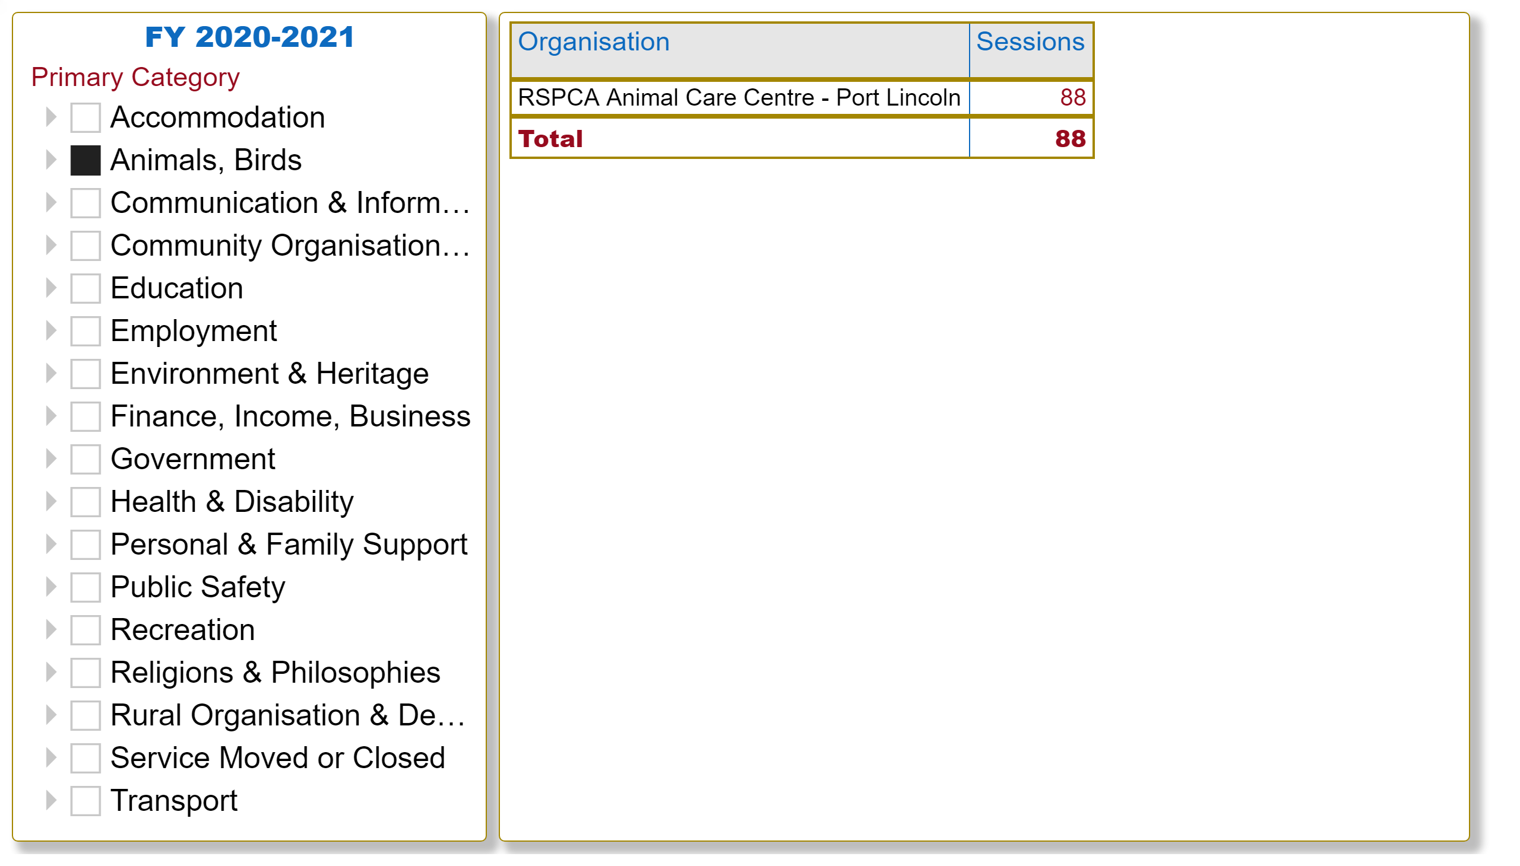
Organisations by Primary Category - Slicer View
Notes:
tableEx
No alt text provided.
FY 2020-2021
No alt text provided.

